Slide 1
Cornerstone City Church Peninsula Plus Community Hoo Are Ya 02-04-2023

Slide 2
Great Big God
CCLI Song # 3373437
Jo Hemming | Nigel Hemming
© 2001 Vineyard Songs (UK/Eire) (Admin. by Integrity Music Ltd)
For use solely with the SongSelect® Terms of Use. All rights reserved. www.ccli.com
CCLI Licence No. 33265

Slide 3
1/2
Our God is a great big God
Our God is a great big God
Our God is a great big God
And He holds us in His hands

Slide 4
2/2
He's higher than a skyscraper
And He's deeper than a submarine
He's wider than the universe
And beyond my wildest dreams
And He's known me and He's loved me
Since before the world began
How wonderful to be a part of
God's amazing plan

Slide 5
Raise A Hallelujah
CCLI Song # 7119315
Jake Stevens | Jonathan David Helser | Melissa Helser | Molly Skaggs
© 2018 Bethel Music Publishing (Admin. by Song Solutions)
For use solely with the SongSelect® Terms of Use. All rights reserved. www.ccli.com
CCLI Licence No. 33265

Slide 6
1/7
I raise a hallelujah in the presence of my enemies I raise a hallelujah louder than the unbelief I raise a hallelujah my weapon is a melody I raise a hallelujah Heaven comes to fight for me

Slide 7
2/7
I’m gonna sing in the middle of the storm Louder and louder you’re gonna hear my praises roar Up from the ashes hope will arise Death is defeated the King is alive

Slide 8
3/7
I raise a hallelujah with everything inside of me I raise a hallelujah I will watch the darkness flee I raise a hallelujah in the middle of the mystery I raise a hallelujah fear you lost your hold on me

Slide 9
4/7
Sing a little louder (Sing a little louder) Sing a little louder (Sing a little louder)

Slide 10
5/7
Sing a little louder in the presence of my enemies Sing a little louder louder than the unbelief Sing a little louder my weapon is a melody Sing a little louder Heaven comes to fight for me

Slide 11
6/7
I’m gonna sing in the middle of the storm Louder and louder you’re gonna hear my praises roar Up from the ashes hope will arise Death is defeated the King is alive

Slide 12
7/7
I raise a hallelujah
I raise a hallelujah I raise a hallelujah I raise a hallelujah

Slide 13
Battle Belongs
CCLI Song # 7148126
Brian Johnson | Phil Wickham
© Phil Wickham Music (Admin. by / Small Stone Media BV, Holland (Admin. in the UK/Eire by Song Solutions www.songsolutions.org))
Simply Global Songs (Admin. by / Small Stone Media BV, Holland (Admin. in the UK/Eire by Song Solutions www.songsolutions.org))
Bethel Music Publishing (Admin. by Song Solutions)
For use solely with the SongSelect® Terms of Use. All rights reserved. www.ccli.com
CCLI Licence No. 33265

Slide 14
1/4
When all I see is the battle
You see my victory
When all I see is a mountain
You see a mountain moved
And as I walk through the shadow
Your love surrounds me
There's nothing to fear now
For I am safe with You

Slide 15
2/4
So when I fight I'll fight on my knees
With my hands lifted high
O God the battle belongs to You
And every fear I lay at Your feet
I'll sing through the night
O God the battle belongs to You

Slide 16
3/4
And if You are for me
Who can be against me
For Jesus there's nothing
Impossible for You
When all I see are the ashes
You see the beauty
When all I see is a cross
God You see the empty tomb

Slide 17
4/4
(An) Almighty Fortress You go before us
Nothing can stand against
The power of our God
You shine in the shadows
You win every battle
Nothing can stand against
The power of our God

Slide 18


Slide 19
King of Kings
CCLI Song # 7127647
Brooke Ligertwood | Jason Ingram | Scott Ligertwood
© 2019 Fellow Ships Music (Admin. by Essential Music Publishing LLC)
So Essential Tunes (Admin. by Essential Music Publishing LLC)
Hillsong Music Publishing Australia (Admin. by Hillsong Music Publishing UK)
For use solely with the SongSelect® Terms of Use. All rights reserved. www.ccli.com
CCLI Licence No. 33265

Slide 20
1/9
In the darkness we were waiting
Without hope without light
Till from Heaven You came running
There was mercy in Your eyes

Slide 21
2/9
To fulfil the law and prophets
To a virgin came the Word
From a throne of endless glory
To a cradle in the dirt

Slide 22
3/9
Praise the Father
Praise the Son
Praise the Spirit three in one
God of Glory
Majesty
Praise forever to the King of kings

Slide 23
4/9
To reveal the kingdom coming
And to reconcile the lost
To redeem the whole creation
You did not despise the cross

Slide 24
5/9
For even in Your suffering
You saw to the other side
Knowing this was our salvation
Jesus for our sake You died

Slide 25
6/9
And the morning that You rose
All of heaven held its breath
Till that stone was moved for good
For the Lamb had conquered death

Slide 26
7/9
And the dead rose from their tombs
And the angels stood in awe
For the souls of all who'd come
To the Father are restored

Slide 27
8/9
And the Church of Christ was born
Then the Spirit lit the flame
Now this Gospel truth of old
Shall not kneel shall not faint

Slide 28
9/9
By His blood and in His Name
In His freedom I am free
For the love of Jesus Christ
Who has resurrected me

Slide 30
Holy Forever
CCLI Song # 7201044
Brian Johnson | Chris Tomlin | Jason Ingram | Jenn Johnson | Phil Wickham
© Phil Wickham Music (Admin. by / Small Stone Media BV, Holland (Admin. in the UK/Eire by Song Solutions www.songsolutions.org))
Simply Global Songs (Admin. by / Small Stone Media BV, Holland (Admin. in the UK/Eire by Song Solutions www.songsolutions.org))
Capitol CMG Paragon (Admin. by Capitol CMG Publishing)
S. D. G. Publishing (Admin. by Capitol CMG Publishing)
Be Essential Songs (Admin. by Essential Music Publishing LLC)
My Magnolia Music (Admin. by Essential Music Publishing LLC)
Bethel Music Publishing (Admin. by Song Solutions)
Brian and Jenn Publishing (Admin. by Song Solutions)
For use solely with the SongSelect® Terms of Use. All rights reserved. www.ccli.com
CCLI Licence No. 33265

Slide 31
5/10
And the angels cry Holy
All creation cries Holy
You are lifted high Holy
Holy forever

Slide 32
6/10
Hear Your people sing Holy
To the King of Kings Holy
You will always be Holy
Holy forever

Slide 33
7/10
(Jesus) Your name is the highest
Your name is the greatest
Your name stands above them all
All thrones and dominions
All powers and positions
Your name stands above them all

Slide 34
8/10
And the angels cry Holy
All creation cries Holy
You are lifted high Holy
Holy forever

Slide 35
9/10
Hear Your people sing Holy
To the King of Kings Holy
You will always be Holy
Holy forever

Slide 36
10/10
You will always be Holy
Holy forever

Slide 39


Slide 40


Slide 41
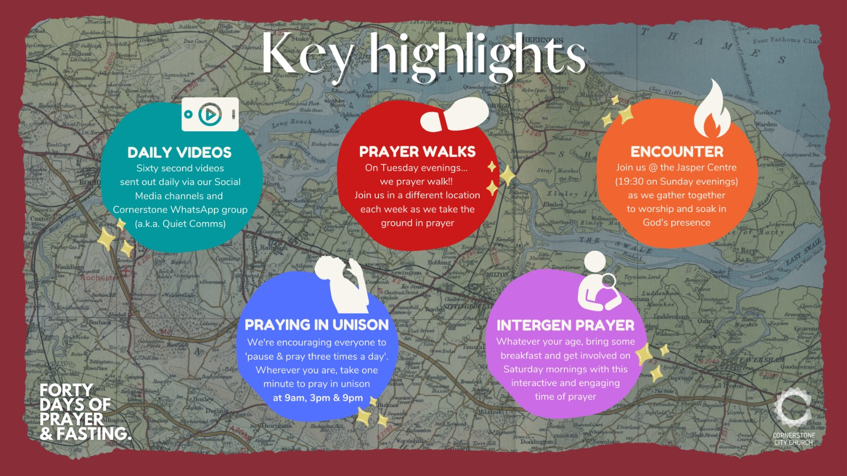

Slide 42
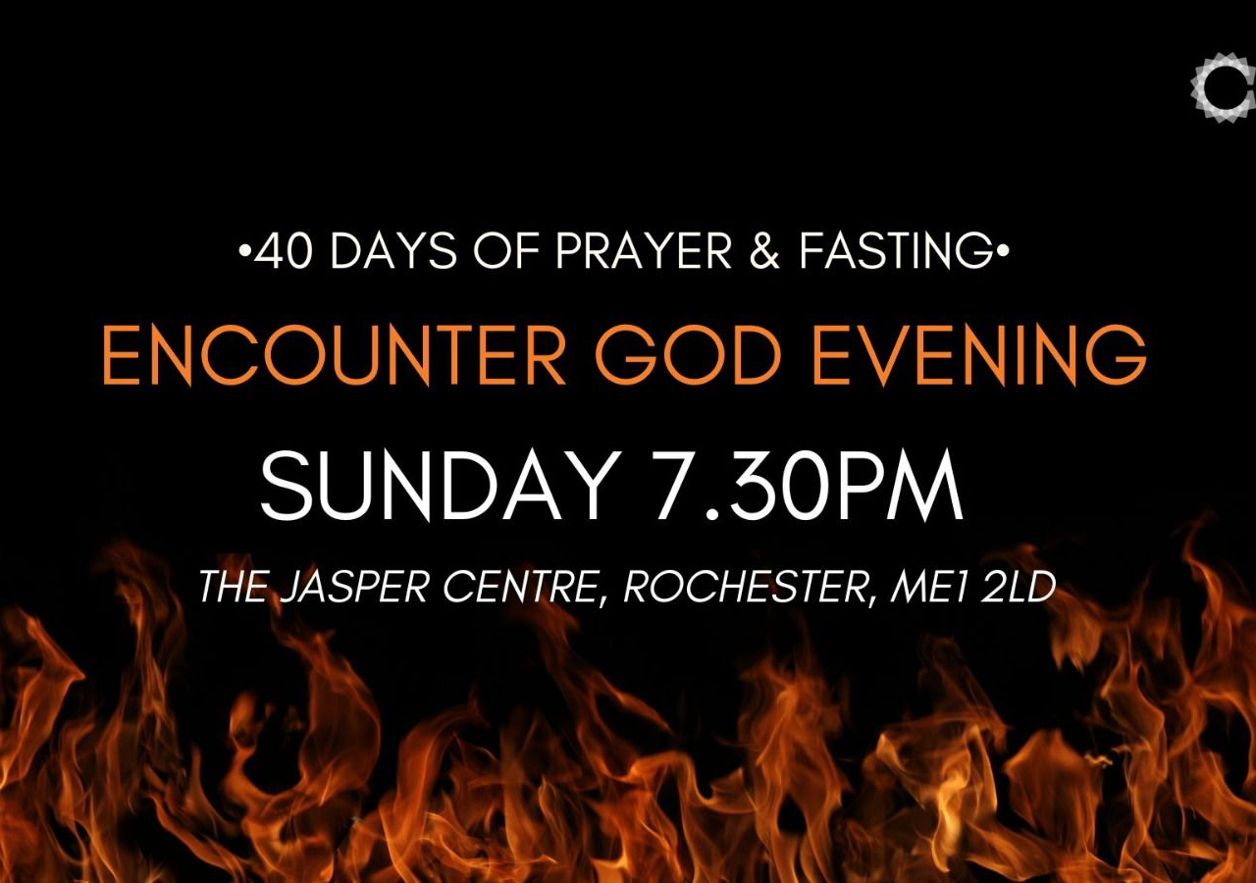

Slide 43
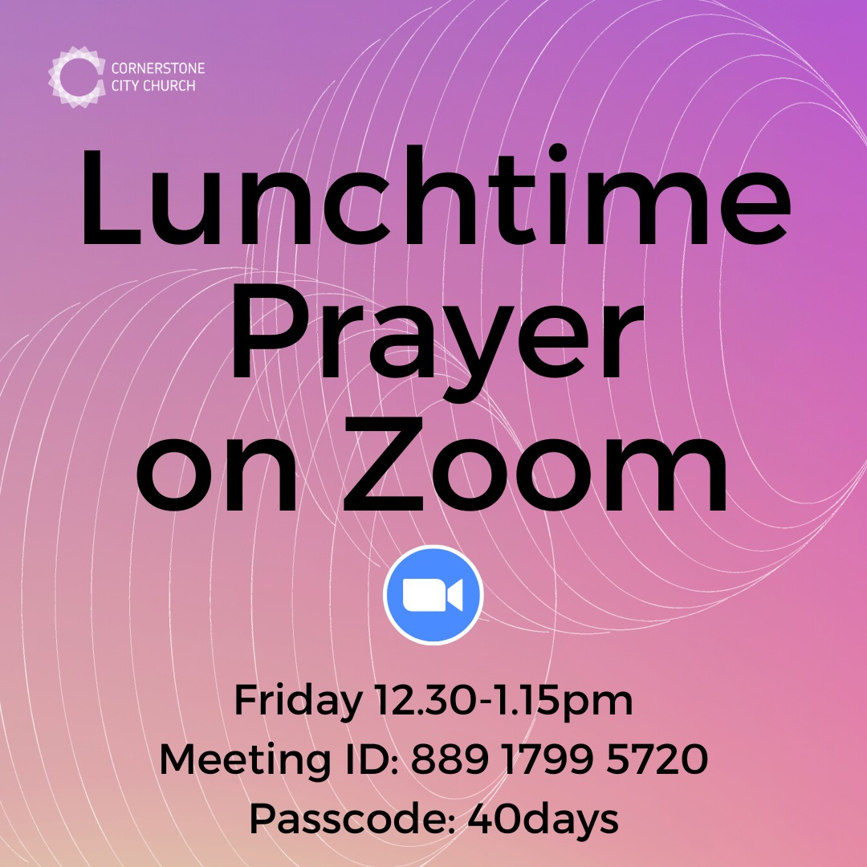

Slide 44


Slide 45


Slide 46


Slide 47

Notes:
Save the dates
Mums and dads, carers and grandparents - you are invited to join Susie, Tom and Jasmine on a Parenting for Faith course.
Parenting is so overwhelming sometimes isn't it? (Or is it just me?! 😅)
We so want our children to grow up knowing and loving God. Let's come together to seek our Father's help and learn from each other along the way.
There will be a couple of in person sessions, and some over Zoom, because we want to make it as accessible as possible.Special plea to Dads - I'd love your company too if you can make it!
Watch the video for more info 👆🏻
Contact Susie (susie@cornerstonecity.co.uk) or Tom (tom@cornerstonecity.co.uk) to find out more.

Slide 48
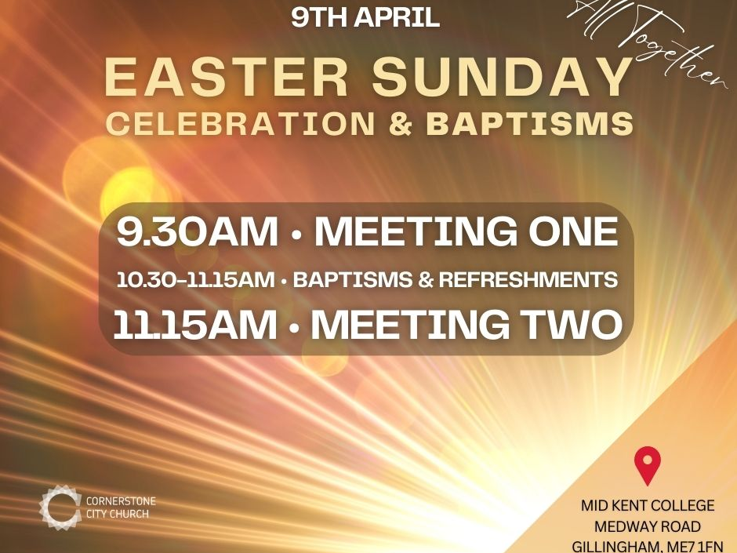

Slide 49


Slide 50


